Slide 1

A place for everything…
The Organisation of Systems
Maintainable Software Series
Fathom Communities of Practise

Slide 2
Maintainable Software Series
In this series…
What is maintainable software?
The naming of things
The organisation of classes
The organisation of components
The organisation of systems

Slide 3
What is maintainable software?

Slide 4
RECAP: Maintainable Software
The Secondary Value of software is its ability to meet the user’s needs today
The Primary Value of software is that it is soft; continuing to meet the ongoing needs of its users for the lifetime of the product
The cost of changing software is time – the time to change it and the time to test the changes
The time required to change software is affected by the naming of things, and the organisation of classes, components and systems

Slide 5
The Organisation of Systems
How can systems be organised to minimise the time required to change and test them?

Slide 6
But first, a history lesson…

Slide 7


Slide 8

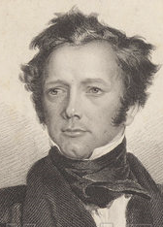
Frederick Marryat
https://en.wikipedia.org/wiki/Frederick_Marryat

Slide 9
In a well-conducted man-of-war every thing is in its place, and there is a place for every thing.
- Frederick Marryat (Masterman Ready, or the Wreak of the Pacific - 1841)
The turn of phrase in this quote is easily associated with the often-heard phrase...
“A place for everything and everything in its place”

Slide 10
In a well-conducted man-of-war every thing is in its place, and there is a place for every thing.
- Frederick Marryat (Masterman Ready, or the Wreak of the Pacific - 1841)
Is this sentiment a comment on the discipline of tidiness?
What makes a system of organisation effective?
What is the central organising principal?

Slide 11
A place for everything
In a software system, if the organisation of that system was assumed to be the “architecture”, is architecture a place for everything?

Slide 12
Software Architecture

Slide 13
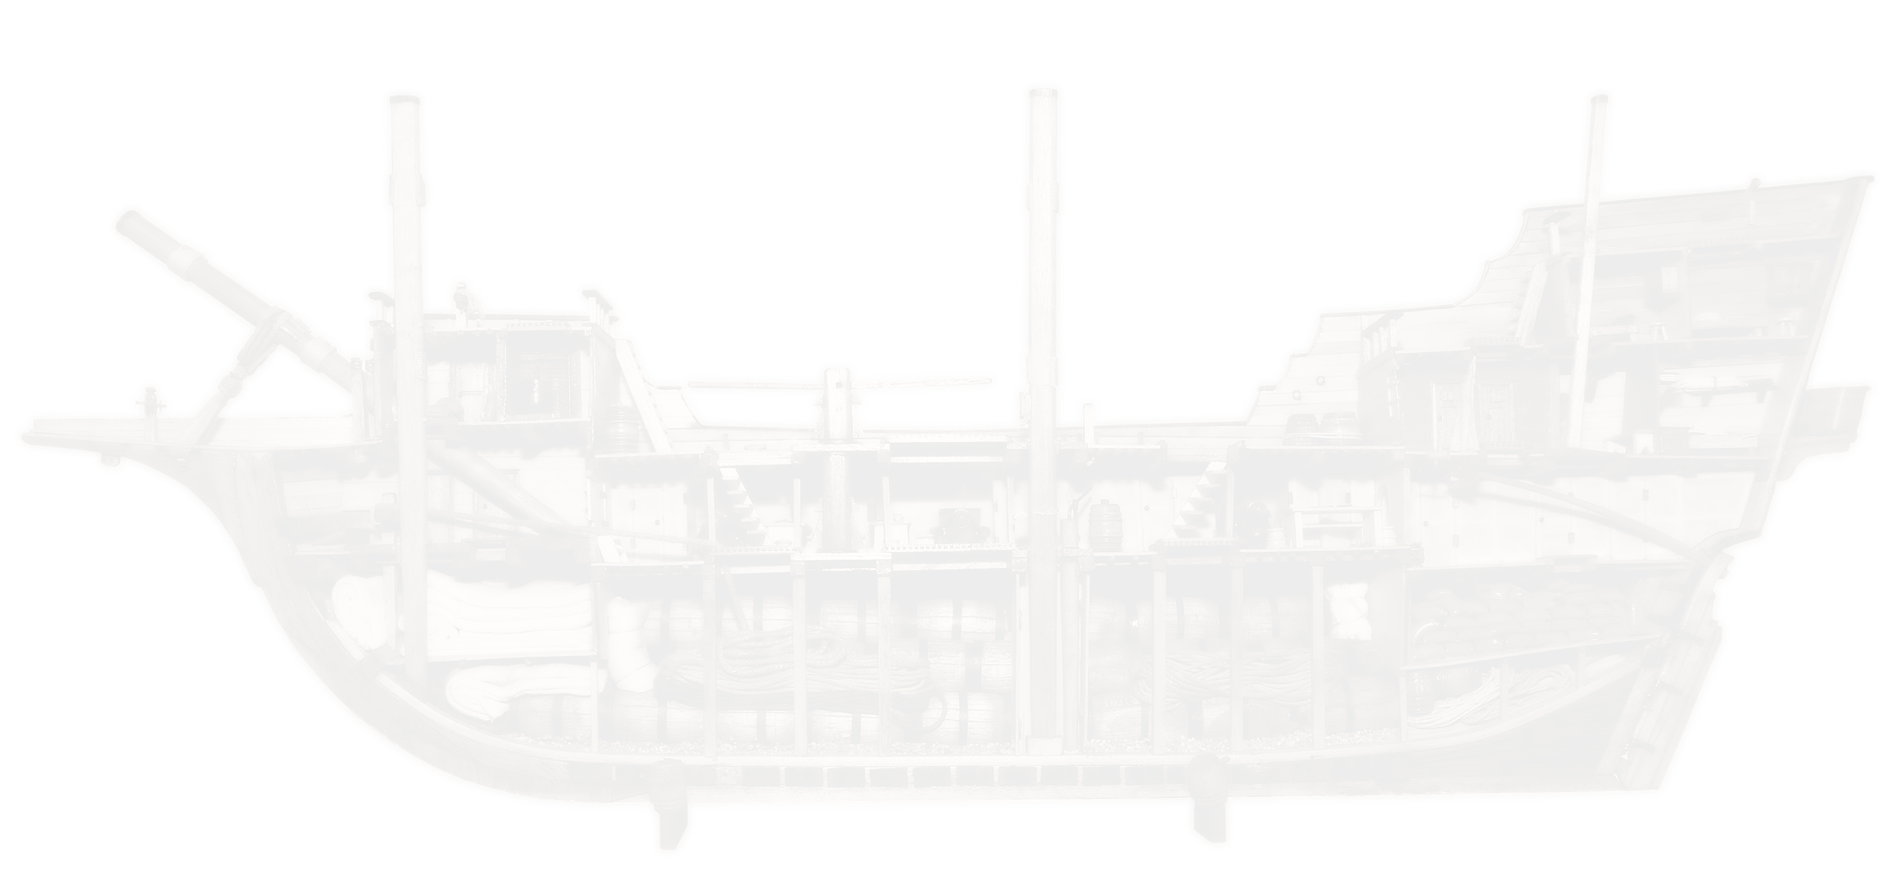
Software Architecture
What is software architecture?
What is the architecture of the application you work on day-to-day?
Is it a “Web app” with a C#, WebAPI, Entity Framework, SQL backend?
What part does WebAPI, SQL and Entity Framework play? Are they components?
Those are all tools - that would be like saying the architecture of a building is hammers and nails, etc.

Slide 14
Software Architecture
Software Architecture, like building architecture, expresses intention
The intention of use
The intented impact of the aesthetics and other factors
The “intention of use” is the central organising principal
The file structure and the code and the tests should communicate the intention, not the tools that were used to construct it…
But how?

Slide 15
Use Cases

Slide 16
A Use Case is a list of steps defining interactions between an actor and a system
- paraphrased from: https://en.wikipedia.org/wiki/Use_case
Use Cases were introduced by Ivar Jacobson in 1992 in the book entitled – Object-Oriented Software Engineering - A Use Case Driven Approach
But who cares?

Slide 17
Use Cases
Use Cases are…
Specific about data and behaviour
Specific about handling exceptions
Non-specific with respect to user-interfaces and tools
How can software systems be organised around Use Cases?

Slide 18
The Clean Architecture
The “Entity Boundary Interactor” Pattern

Slide 19
The Clean Architecture
The EBI Pattern describes an approach to software architecture where Use Cases are the central organising principal
The pattern has been promoted by Robert C. Martin as part of his Clean Code campaign (the Agile methodology - refactoring according to the SOLID principals) to the extent that it is often called the Clean Architecture

Slide 20
The Clean Architecture
In this pattern there are Entities, the Boundary, and Interactors…
The “Entities” contain stand-alone, object oriented business logic
The “Boundary” protects the Use Cases from the delivery mechanisms and from the low-level details
The “Interactors” act as go-betweens for the Boundary and the Entities
It’s easier to call Interactors Use Cases
Let’s take a look…

Slide 21
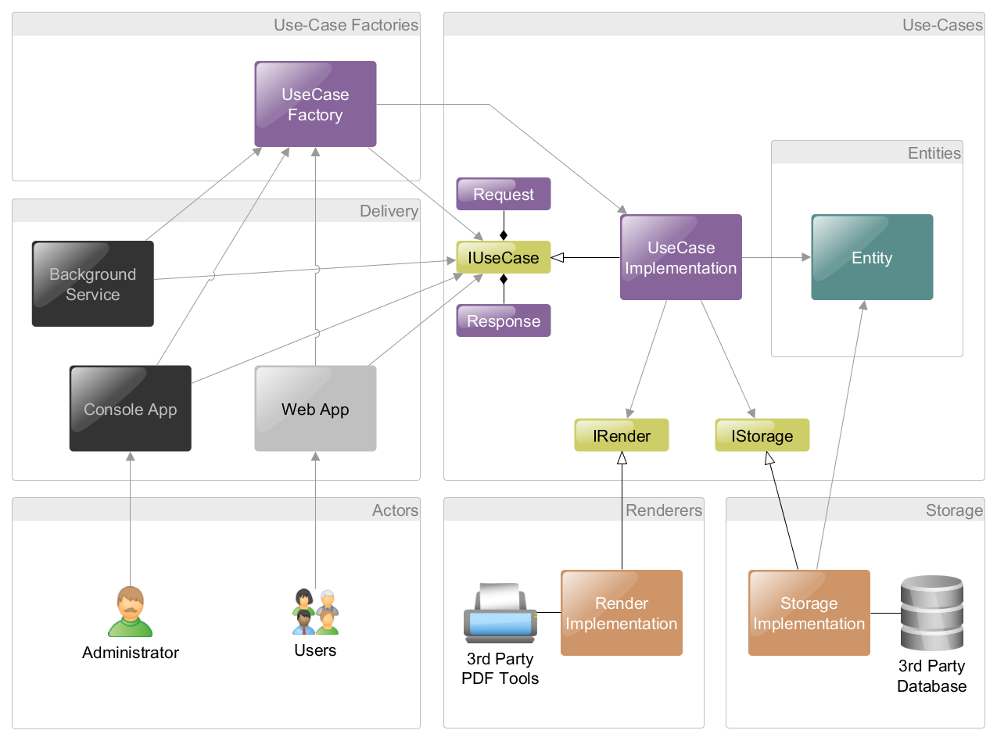

Slide 22
The Clean Architecture
Did you notice the two levels of abstraction?
The Use Case (and higher level business logic) is abstracted from the low-level details
What low-level details? SQL, the DB schema, the PDF renderer, the Azure queue
The Use Case is abstracted from the delivery mechanisms
What delivery mechanisms? MVC, Web API, Console, Windows Service
Let’s look again…

Slide 23
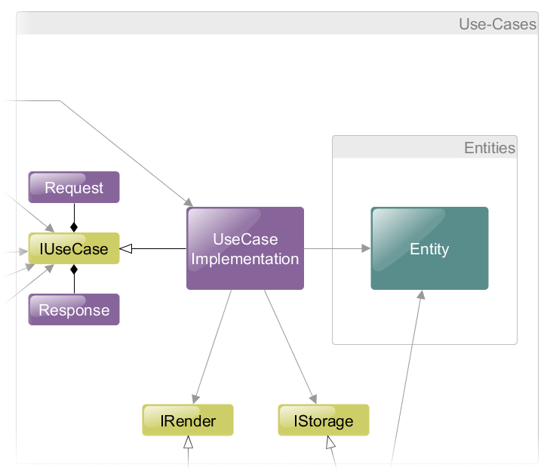
The Clean Architecture
Entities have no dependencies at all; except for other entities
Use Cases never expose Entities and only return Response models
Use Cases depend on Entities and Boundary interfaces. They only use third party components through interfaces

Slide 24
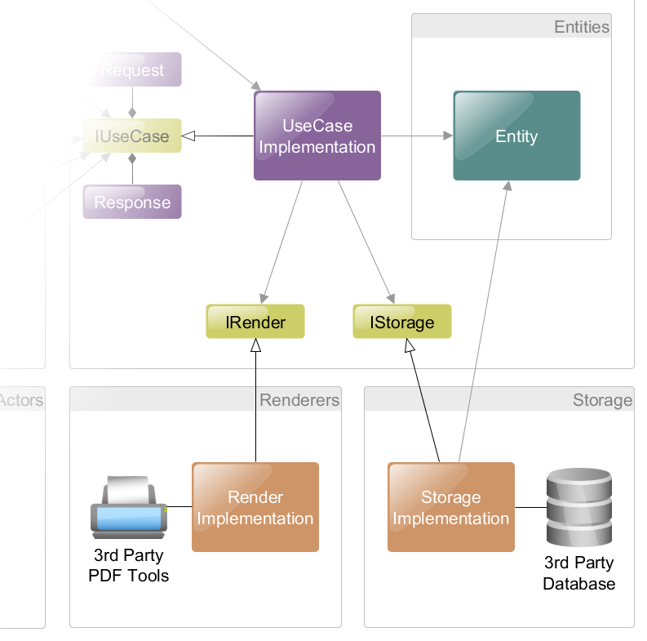
The Clean Architecture
Dependency implementations, such as storage, may access Entities and Request/Response models.

Slide 25
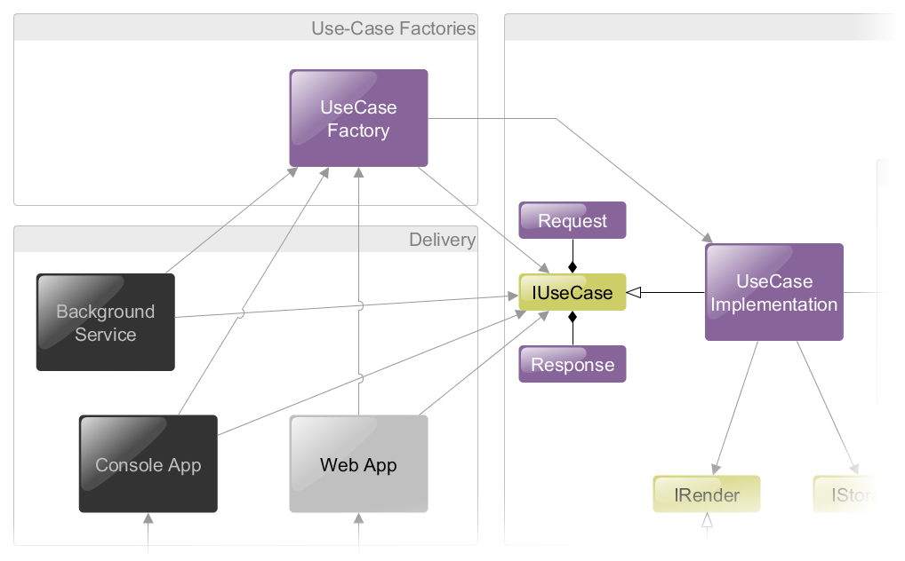
The Clean Architecture
Delivery mechanisms access Use Cases via Request/Response models and the Use Case Boundary interface

Slide 26
The Clean Architecture
Benefits:
When developing a system, it is possible to create and test use-cases and entities without first deciding which third-party tools to use
Those decisions can be delayed until the maximum amount of knowledge concerning their requirements is known.
At any time, it is possible…
To replace a third party tools with another
To replace a user-interface with another
To create an additional user-interface

Slide 27
A) High-level modules should not depend on low-level modules. Both should depend on abstractions. B) Abstractions should not depend on details. Details should depend on abstractions.
- The Dependency Inversion Principal ~ Robert C. Martin (Early 2000’s)
The EBI Pattern employs the Dependency Inversion Principal
This is the “D” in the S.O.L.I.D. Principals

Slide 28
The S.O.L.I.D. Principals
S – Single Responsibility Principal
A class should only have a single responsibility – wrt one actor; having one reason to change
O – Open/Closed Principal
Entities should be open for extension, but closed for modification
L – Liskov Substitution Principal
Subtypes must always be substitutable for their parent types
I – Interface Segregation Principal
Many client-specific interfaces are better than one general-purpose interface
D – Dependency Inversion Principal
High-level logic should not depend on low-level details; both should depend on abstractions

Slide 29
Example

Slide 30
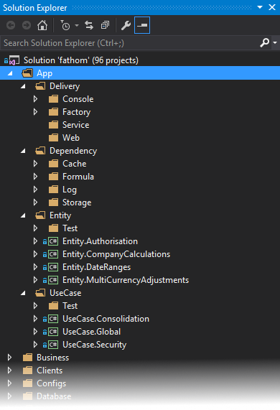
Example
In the Solution Explorer…
“Delivery” contains the delivery mechanism projects by type of delivery
“Dependency” contains the UseCase dependencies
“Entity” contains the stand-alone, global business logic
“UseCase” contains the business logic for when an Actor interacts with the system

Slide 31
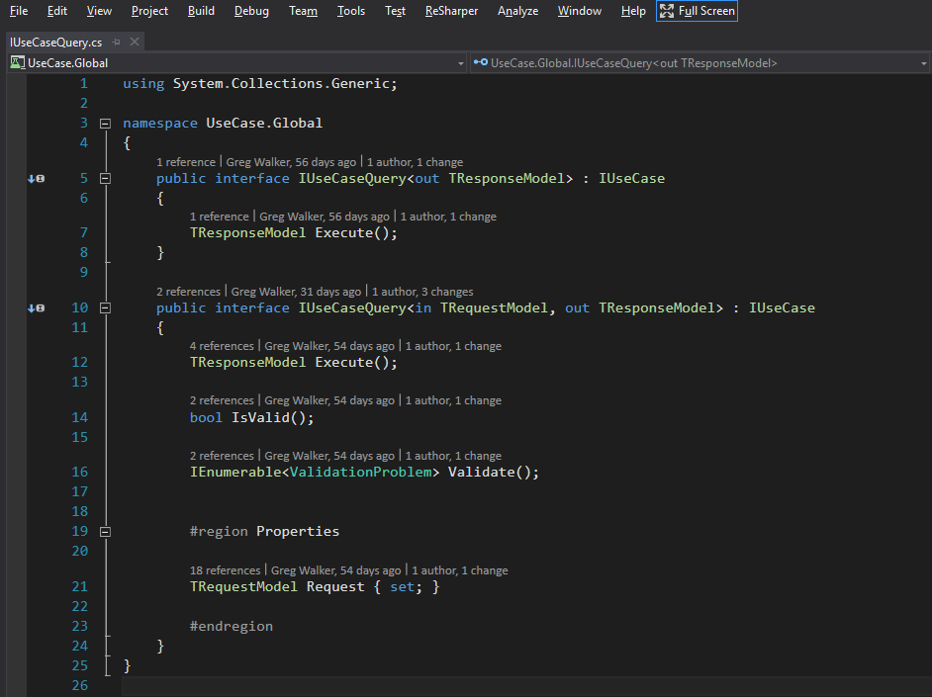
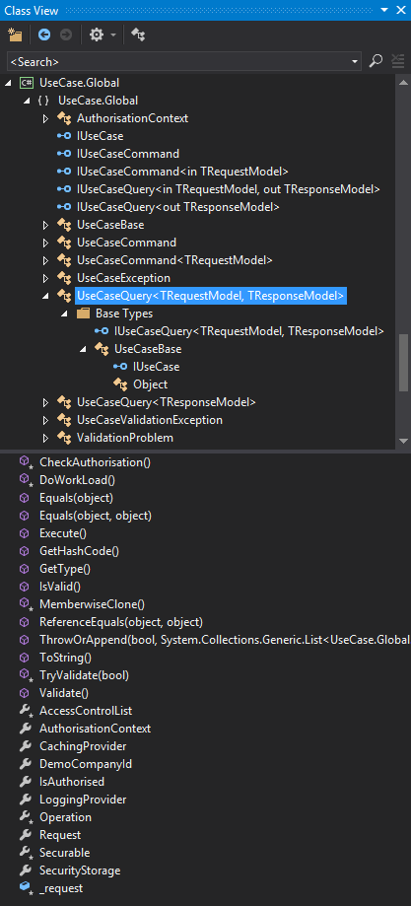

Slide 32
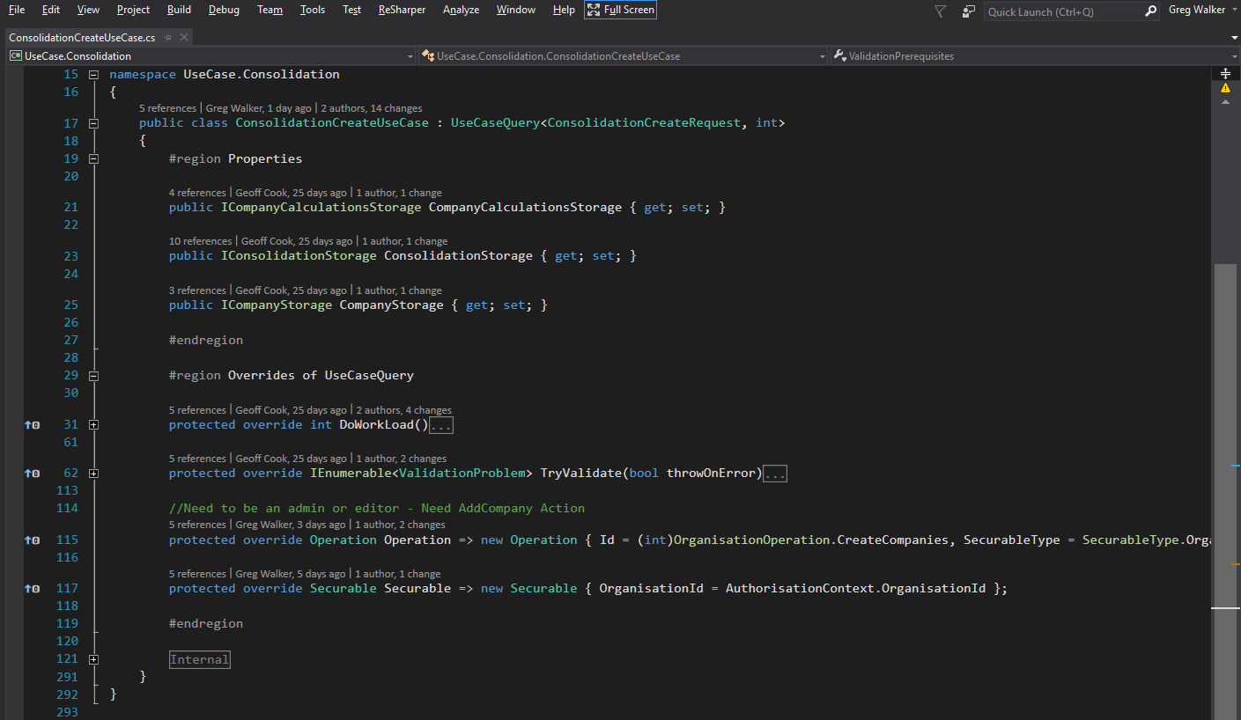

Slide 34
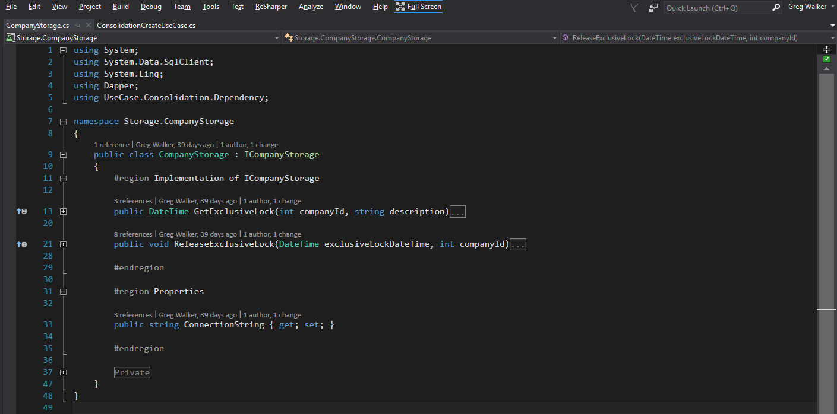

Slide 35
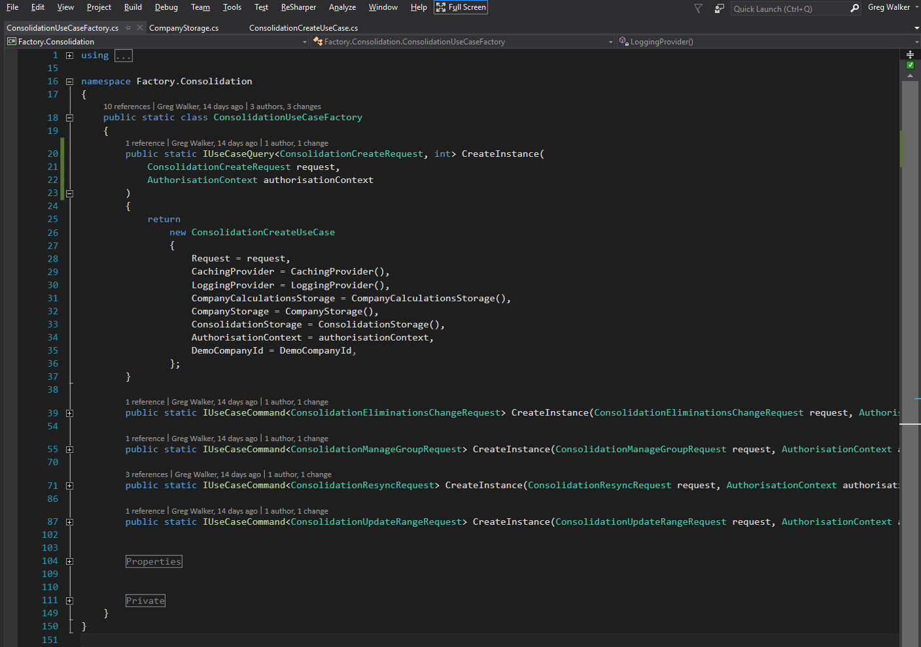

Slide 36
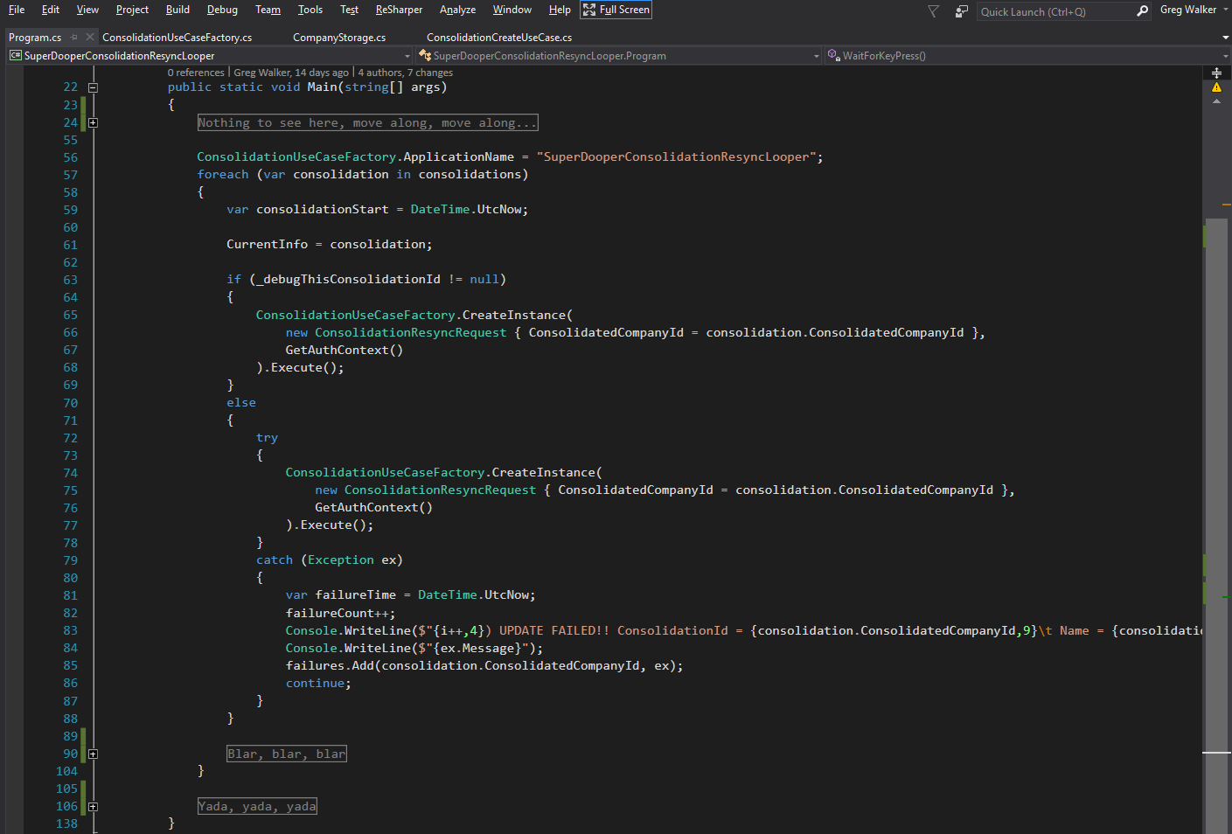

Slide 37
Summary

Slide 38
Summary
The value of Clean Architecture is it maximises the Primary Value for the least cost
The Primary Value of software is that its soft; and can be changed
The cost of changing software is time
The time required to change software is affected by the organisation of systems

Slide 39
Summary
Having a place for everything does not constitute an architecture
Organising a system around its intended use makes it intuitive because the Use Cases are seen prominently, and the tools and low-level details are hidden away

Slide 40
Summary
Clean Architecture…
Organises a software system around its Use Cases
Protects the Use Cases from low-level details (via the Dependency Inversion Principal)
Protects the Use Cases from the delivery mechanisms (via the Command pattern)
Provides flexibility for testing and for future changes

Slide 41
A place for everything…
The End

Slide 42
The End

